Slide 1


Slide 2
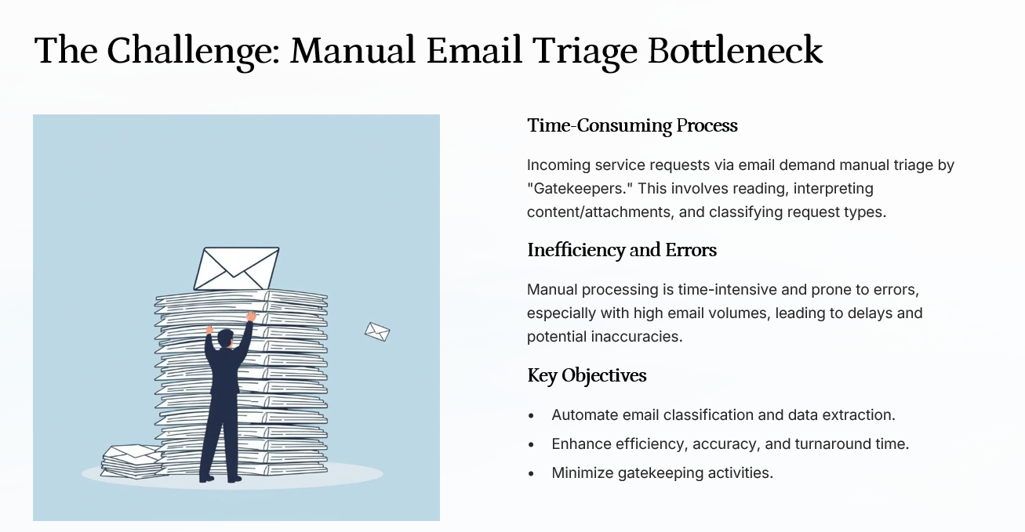

Slide 3
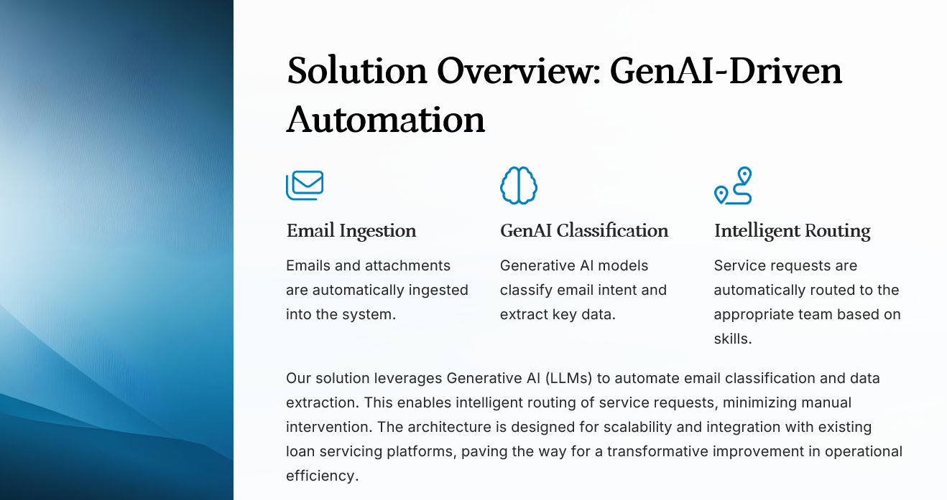

Slide 4
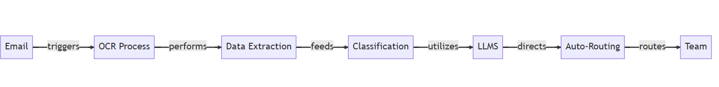
We extract data from incoming emails using OCR, while the classification is powered by Gemma2b a Large Language Model (LLM).
Key elements like ID, category, and email body are extracted, with a confidence score assigned.
Based on this information, requests are automatically routed to the appropriate team, including request type and sub-type.
The frontend is built with Next.js, the backend uses MySQL and FastAPI, ensuring efficient processing and routing of email data.

Slide 5
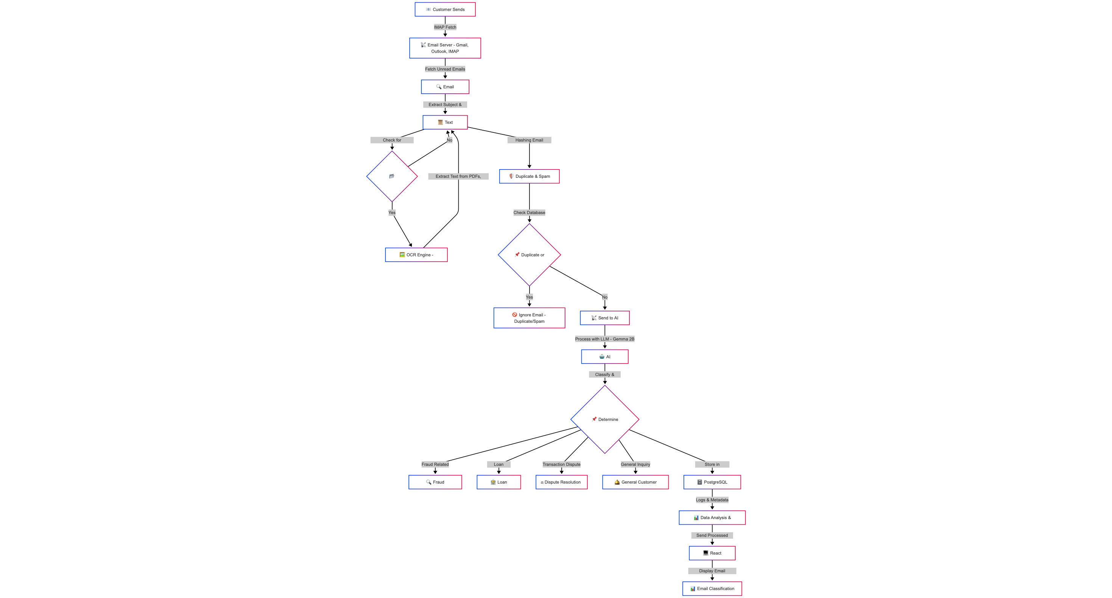

Slide 6
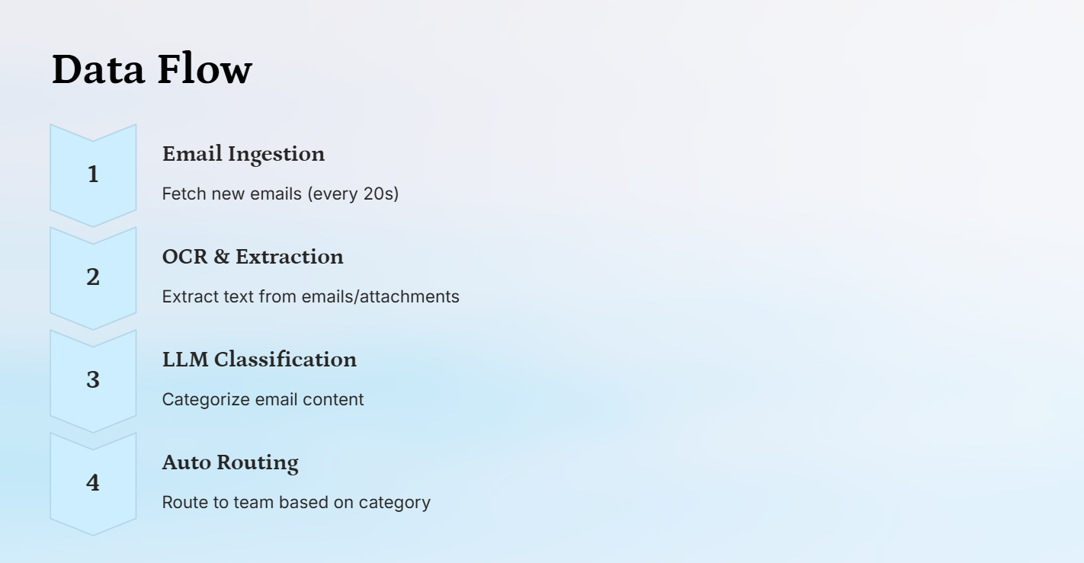
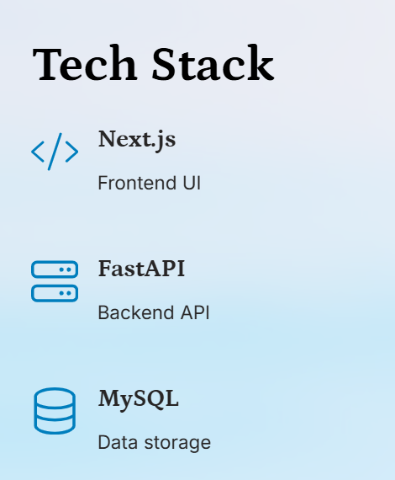

Slide 7
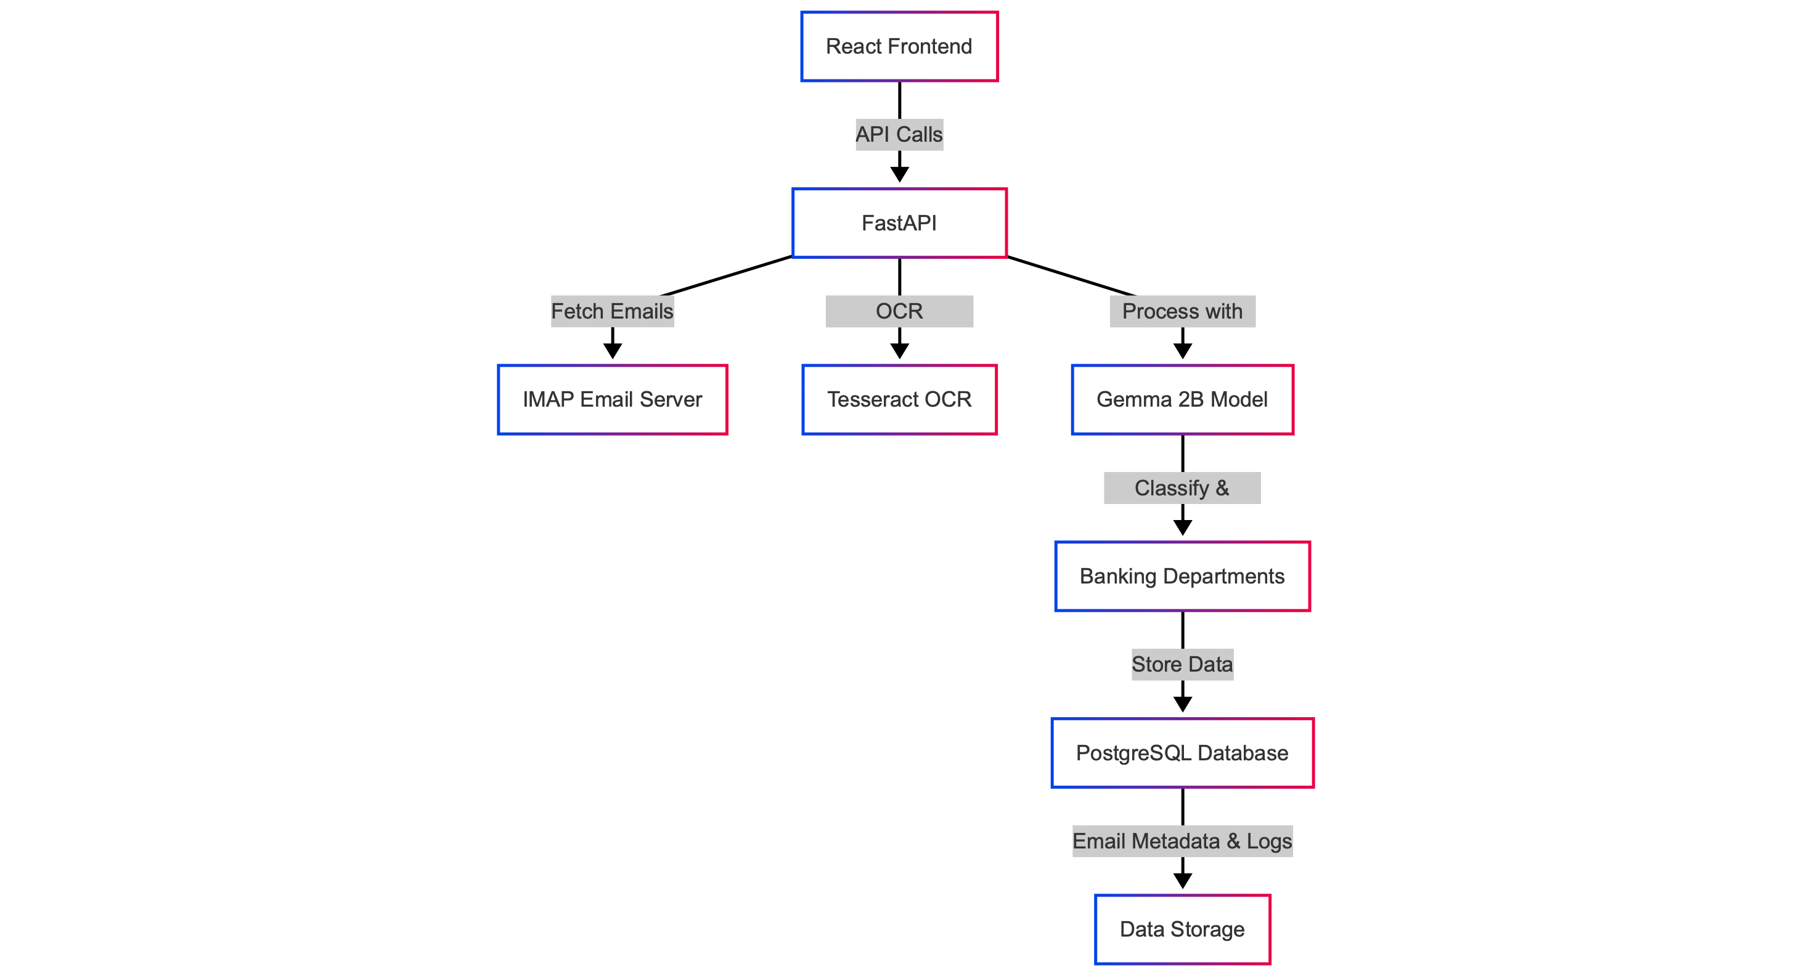

Slide 8
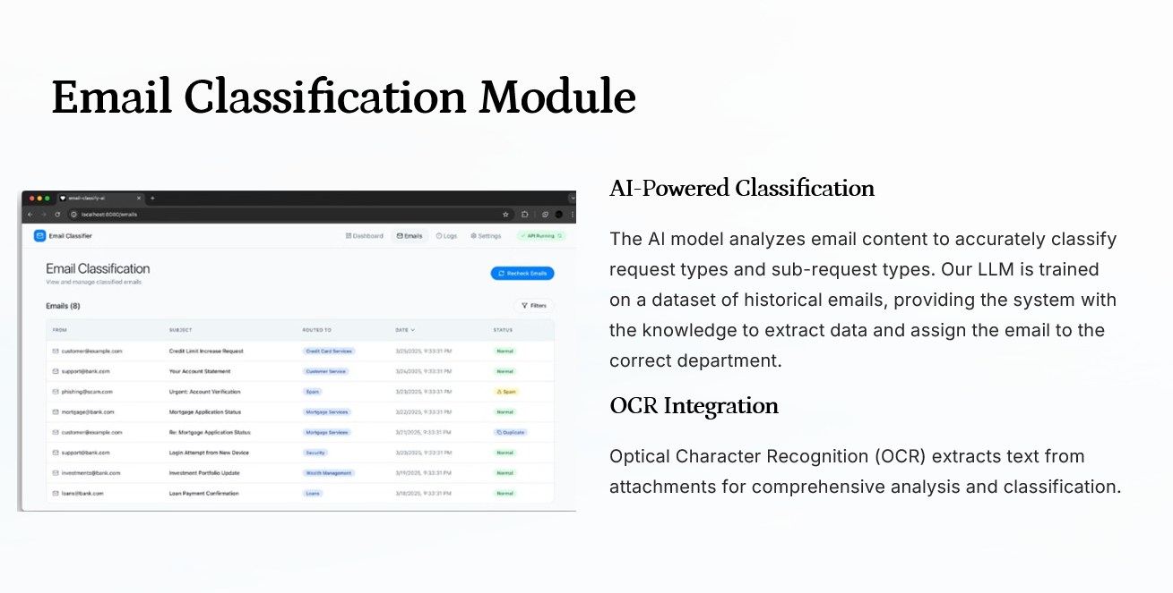

Slide 9
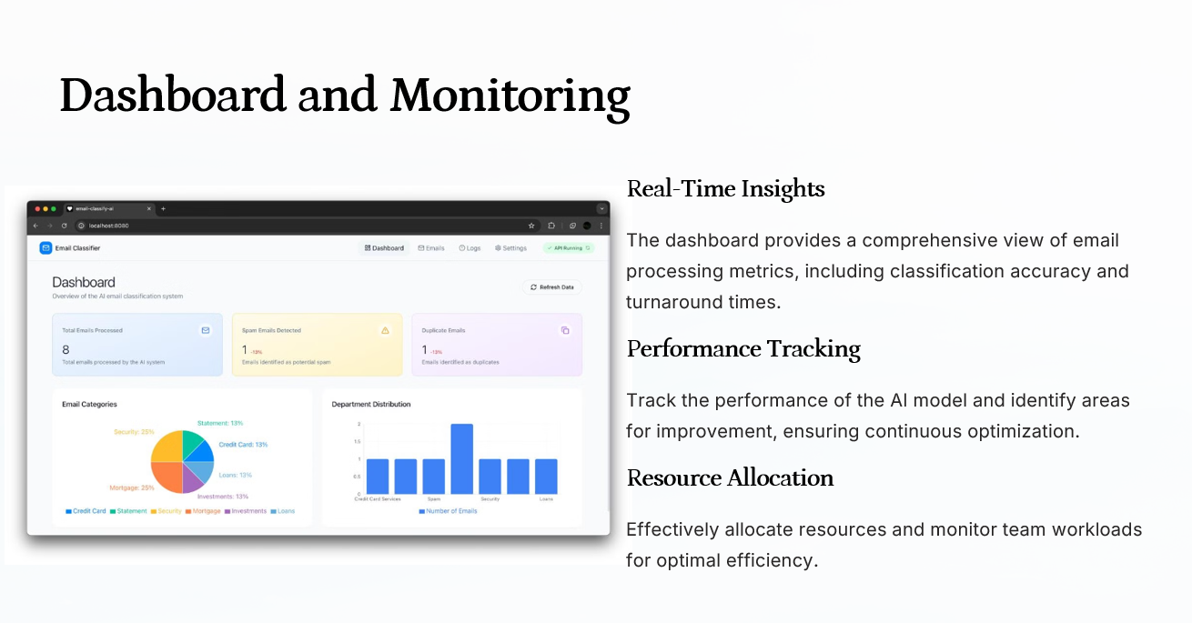

Slide 10
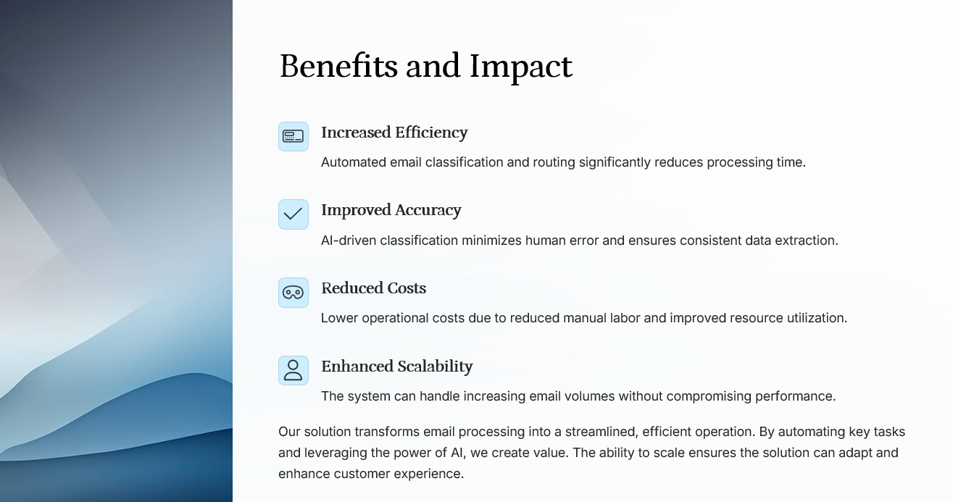

Slide 11
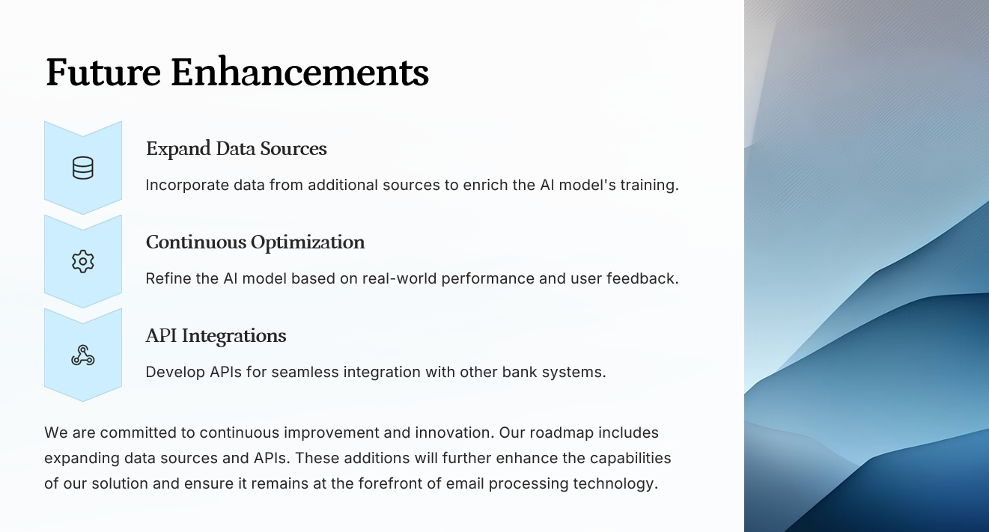

Slide 12
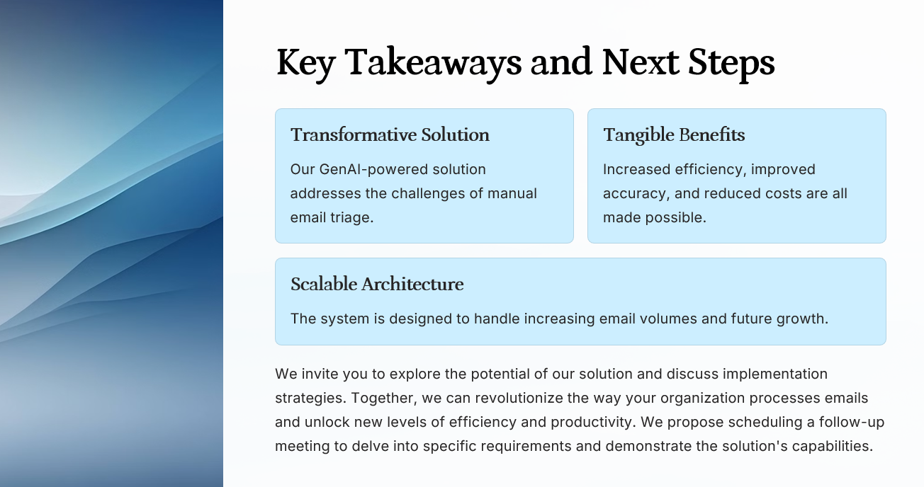

Slide 13
